Slide 1
Technology and Innovation update
Recent advancement in QSAR utilizing AI for toxicology
prediction
Max Sharifi & Dongdong Zhang
May 2024

Slide 2




Why these in-silico models are important to us?
Minimizing animal testing for the Registration, Evaluation, and Authorization of
Chemical Substances (REACH)
REACH legislation testing program was intended to ensure that animals would
be used only as a last resort
What does this mean for registrants?
- societal demands for safer and sustainable chemical products
PETA Consortium

Slide 3
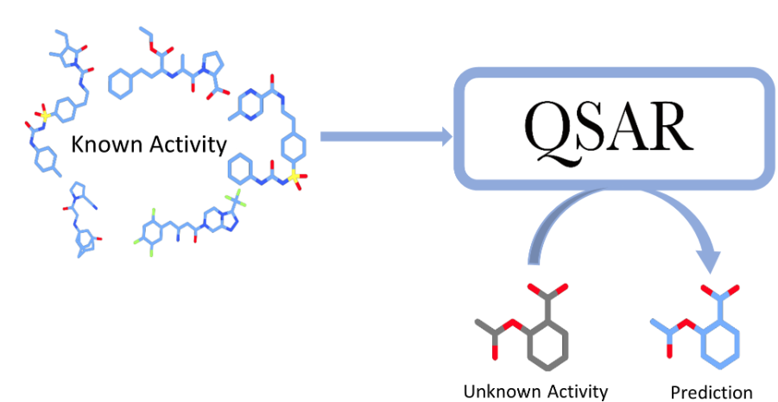
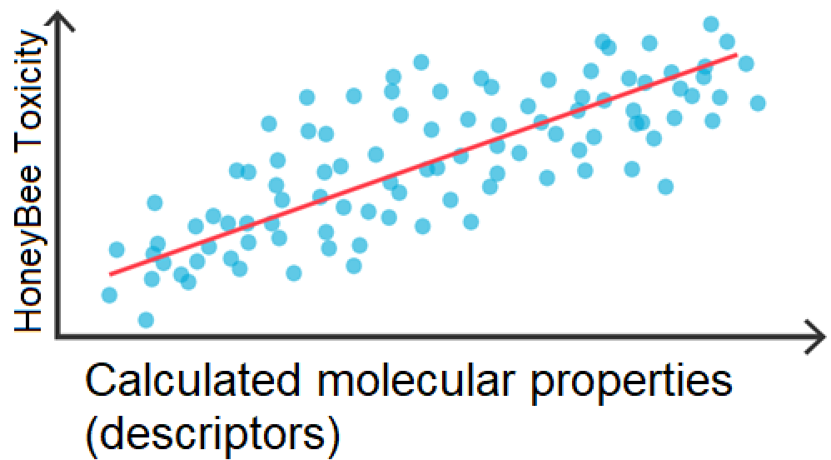
QSAR models, what are they and how are they created?
The development of QSAR models requires the prior characterization of the molecules whose properties are known through numerical descriptors.
That is, the structure of the compounds is transformed into ‘descriptors’, parameters that associate numerical values ​​to each compound based on the characteristics of its structure.

Slide 4
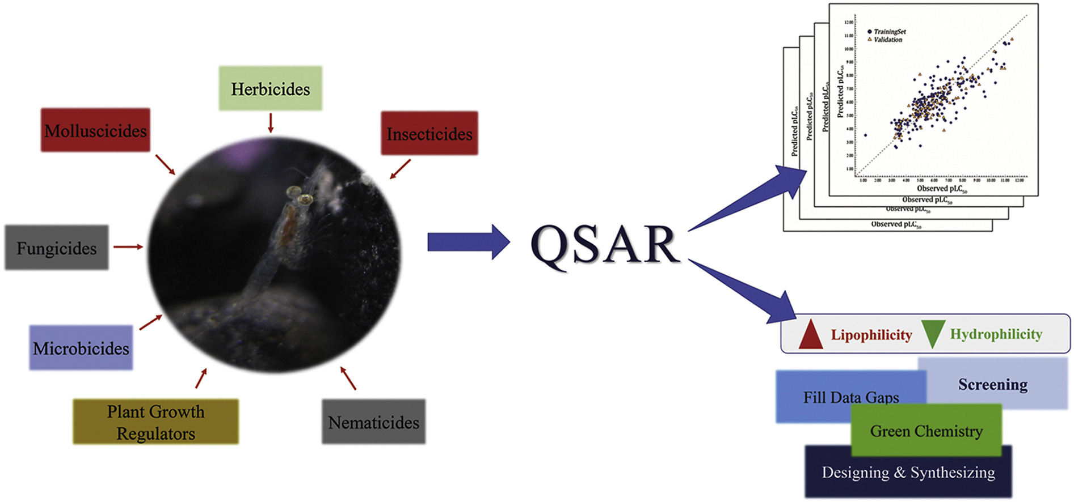

Increasing Trend in Toxicological Evaluations for Pesticides Registration
1) To consider that the model is scientifically valid
2) Ability to demonstrate that the model we are using is applicable to chemical which we making predictions on (Applicability Domain), that means how similar is the pesticide-candidate of interest to the chemicals of the model
3) To ensure that the QSAR model is relevant to the regulatory purpose for the particular registration that’s considered

Slide 5

OECD guidance #194 (first draft April-2024), on QSARs and Grouping of Chemicals
258-page document on assessment framework and guidance for the regulatory assessment, including grouping, metabolites, fingerprints, chemical similarities, alert rule bases, or QSAR model predictions and read-across performance

Slide 6
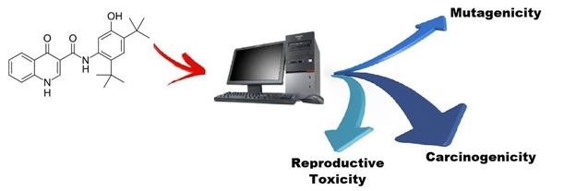
Regulatory use of QSAR
For agrochemicals, QSAR modeling can be applied in the development of new active ingredients
QSAR modeling are rapidly gaining acceptance by regulatory agencies around the world
QSAR studies are often required by regulators during the pesticide registration process, including the Brazilian Health Regulatory Agency (ANVISA) and the Federal Commission for the Protection against Sanitary Risk (COFEPRIS) in Mexico
The US-EPA recognizes QSAR studies as a valuable predictive tool to consider when applying Integrated Approaches to Testing and Assessment (IATA) to pesticide assessments for FIFRA registration
QSARs can provide component to build-up the Weight of Evidence to help understand a particular decision
and are often being used to understand chemical similarity, leading to mechanistic similarity

Slide 7
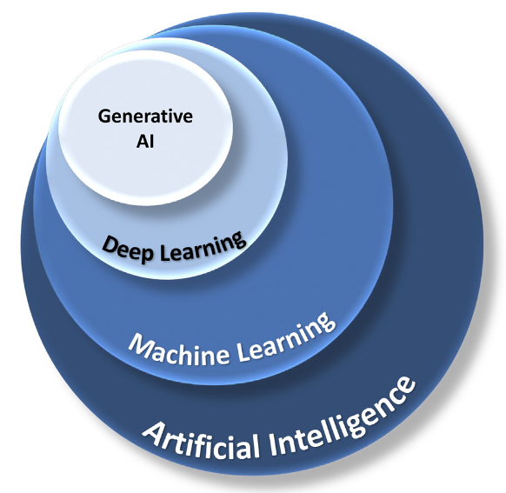
AI/ML Scope
AI refers broadly to mimicking human intelligence via machines/software, with the goal of performing tasks requiring intelligence
ML is an AI subset specifically involving data-driven algorithm improvement
The relationship between AI, ML, deep learning, and generative AI.
Tonoyan, L. et al. Front. Drug Discov. 2024, 4, 1336025.

Slide 8
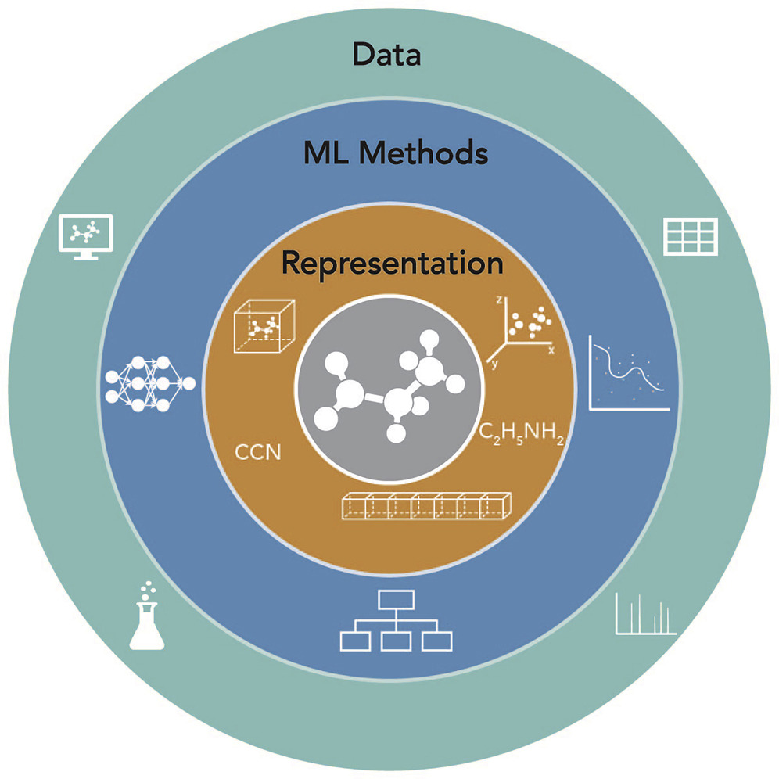
AI/ML in Molecular Sciences
Three fundamentals
Haghighatlari, M. et al. Chem 2020, 6 (7), 1527–1542.

Slide 9
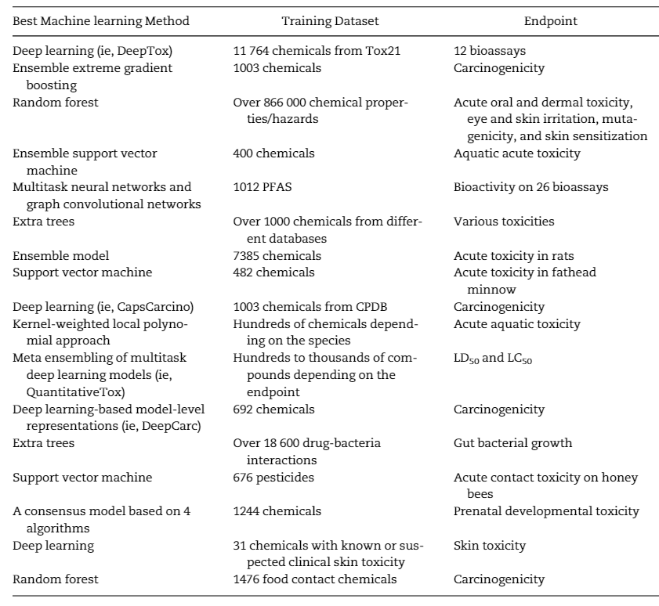
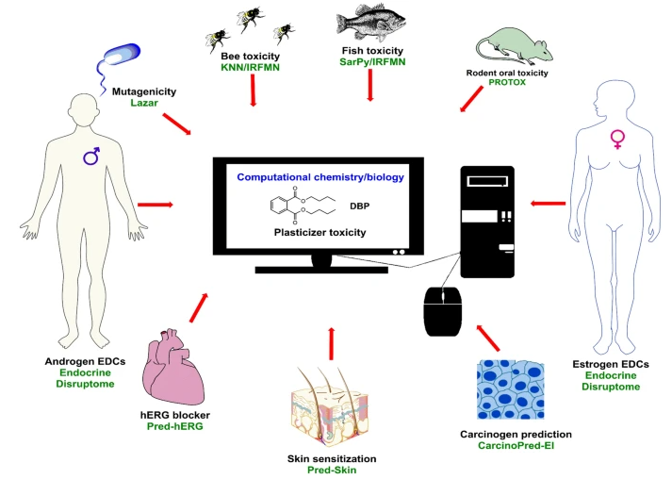

ML applications in toxicology
ML Algorithms
Datasets
Endpoints
ML-based
QSAR
In silico analysis of various predictive toxicity analysis
(https://scistore.cambridgesoft.com/chembiodraw/)
Lin, Z. et al. Toxicol. Sci. 2022, 189 (1), 7–19.

Slide 10
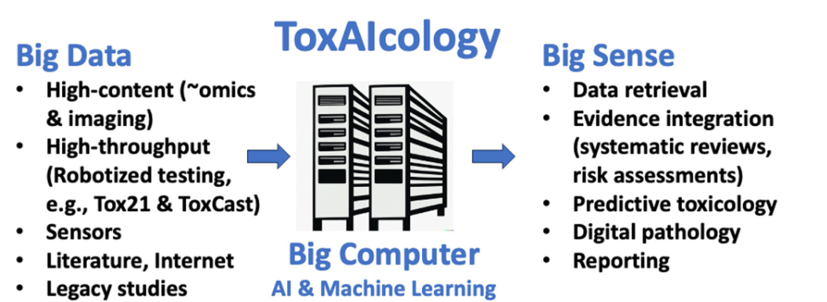
ML applications in toxicology
AI can revolutionize toxicology via:
AI-Enhanced Toxicity Understanding
Improved Risk Prediction
Novel Treatment Development
Hartung, T. Front. Artif. Intell. 2023, 6, 1269932.

Slide 11


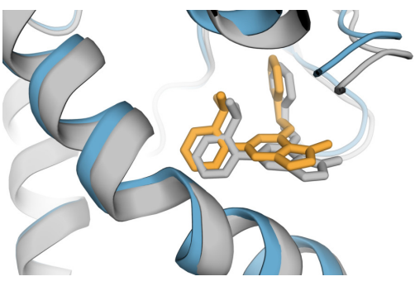
Generative AI
Generative artificial intelligence (AI) describes algorithms (such as ChatGPT) that can be used to create new content, including audio, code, images, text, simulations, and videos.
Four main classes: Generative Adversarial Network (GAN), Variational Autoencoder, Flow Model, and Diffusion model
Text-to-Text
Text-to-Picture
AlphaFold 3
https://www.xenonstack.com/blog/generative-ai-models
Google Deep Mind. Nature. 2024.

Slide 12
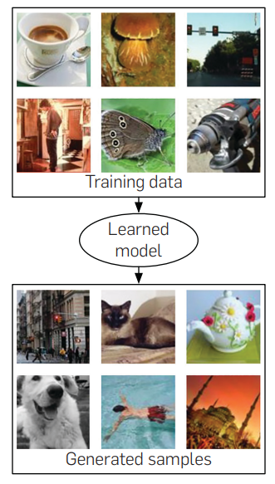
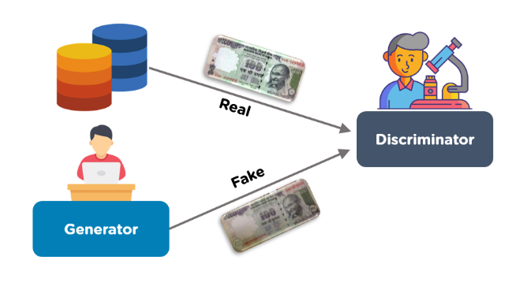
Generative Adversarial Networks (GANs)
Goodfellow, I. et al. Commun. ACM 2020, 63 (11), 139–144.

Slide 13
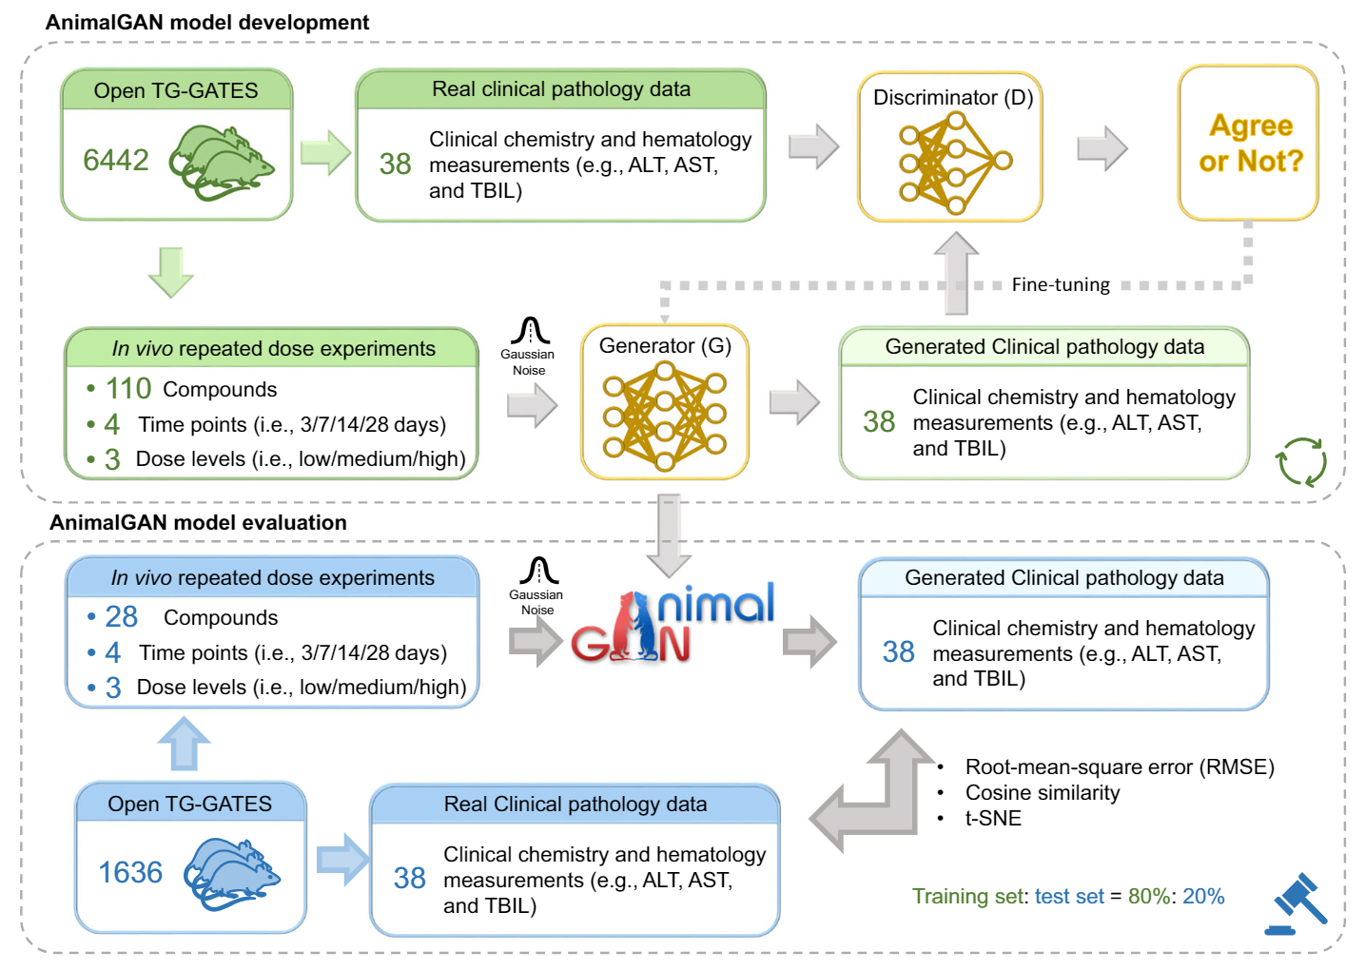
GenAI application in toxicology: AnimalGAN from FDA
AnimalGAN established the association between chemical exposure (the combination of chemical, dose, and exposure duration) and clinical pathology ﬁndings (e.g., clinical chemistry and hematologic measures) in legacy animal study data to generate synthetic clinical pathology proﬁles for new and untested drugs and other chemicals in a predeﬁned dose and treatment duration.
GitHub: https://github.com/XC-NCTR/AnimalGAN/tree/main
Chen, X. et al. Nat. Commun. 2023, 14 (1), 7141.
Igarashi, Y. et al. Nucleic Acids Res. 2015, 43 (D1), D921–D927

Slide 14
Summary
AI presents exciting opportunities through enhanced prediction, reduced animal testing, and other innovations.
Carefully addressing the challenges such as data availability/quality, model interpretability can lead to transformative contributions of AI to advancing toxicology and safety.
Future: Several potentially transformative directions for integrating AI into modern toxicology include:
Precision toxicology incorporating genetic, microbiome, and exposure information
Explainable and trustworthy AI techniques increasing model interpretability and transparency to elucidate mechanisms and meet regulatory needs.
T. Hartung. ALTEX 40(4), 2023

Slide 15
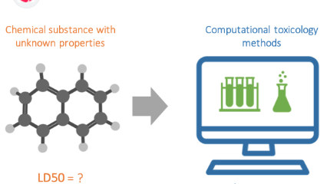
Thank you for your attention!

